Slide 1

Human Resource Dashboard
Digital Egypt Pioneers Initiative – DEPI2025

Slide 2

Team Member
Ahmed Khaled
Rashad Maher Rashad
Sameh Ali Mohamed
Esraa Hossam Eldin Ahmed
Ahmed Abass
Alaa Moazz

Slide 3

Agenda:
Data Uploading
Data Cleaning
Data Modeling and Relationships
Dax Measures and Tables
Interactive Reports
Dashboard Publishing
Recommendations
Notes:
Data Cleaning: Remove errors and duplicate entries to ensure data quality.
Data Modeling and Relationships: Organize data into a structured format and link related data.
Interactive Visualizations: Build charts and graphs that users can interact with to explore data.
Dashboard Publishing: Share the finalized dashboard for access and use by decision-makers.

Slide 4

Our Promise
The HR Dashboard is designed to provide a centralized and interactive platform for HR professionals and management to:
Provide real-time insights by visualizing key HR metrics and workforce trends.
Track and analyze workforce performance, including employee engagement, turnover, and productivity levels..
Enable data-driven decision-making to identify areas for improvement and optimize HR strategies.
Improve operational efficiency by Accessing critical HR information quickly and easily.

Slide 5
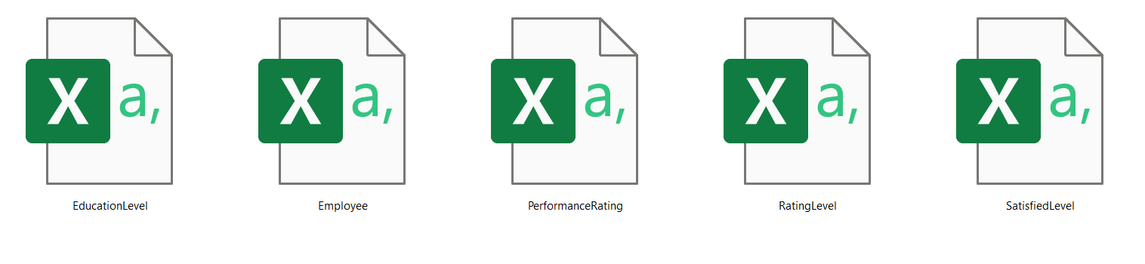
Data Uploading
Receiving 5 Csv files related to employees of company content including:
Educational Level.
Employee
Performance Rating
Rating Level
Satisfied Level
Notes:
Data Model Summary (Star Schema)
PerformanceRating is the fact table, capturing job satisfaction, manager ratings, and environmental satisfaction.
Employee is a dimension table, linked via EmployeeID, providing demographic and job-related data.
EducationLevel connects to Employee, analyzing the impact of education on job roles.
SatisfactionLevel links to PerformanceRating, categorizing employees based on satisfaction scores.
RatingLevel is related to PerformanceRating, defining performance evaluation standards.
One-to-Many relationships ensure structured analysis, with Employee, Education, and Ratings as dimensions.
The model supports workforce insights, helping track performance, satisfaction, and retention trends.

Slide 6
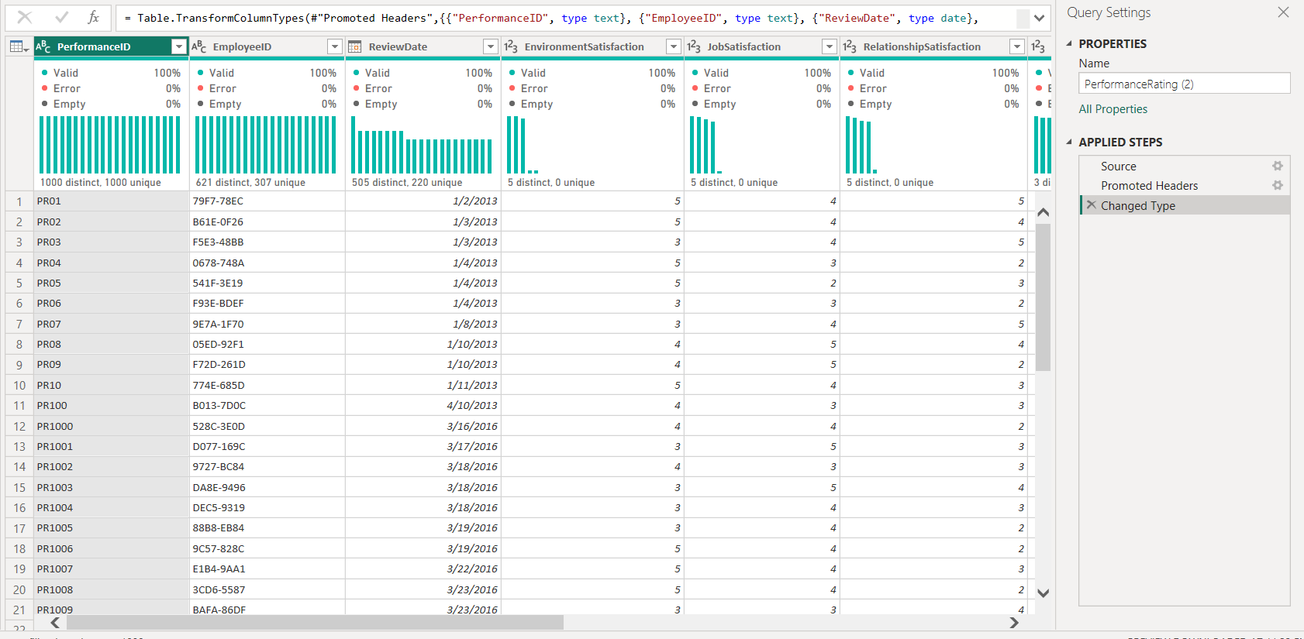
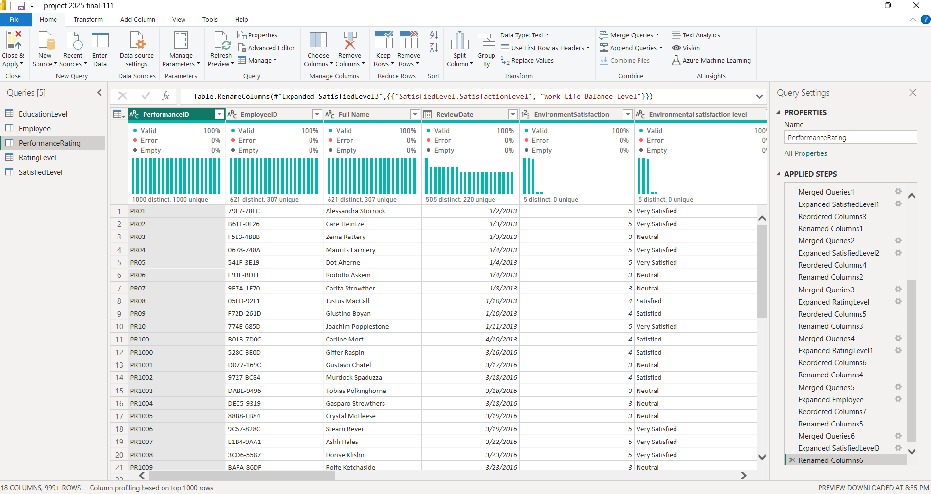
Data Cleaning
Data was cleaned in Power Query by removing errors, renaming columns, and merging related tables efficiently.
Before
After
Notes:
Data Model Summary (Star Schema)
PerformanceRating is the fact table, capturing job satisfaction, manager ratings, and environmental satisfaction.
Employee is a dimension table, linked via EmployeeID, providing demographic and job-related data.
EducationLevel connects to Employee, analyzing the impact of education on job roles.
SatisfactionLevel links to PerformanceRating, categorizing employees based on satisfaction scores.
RatingLevel is related to PerformanceRating, defining performance evaluation standards.
One-to-Many relationships ensure structured analysis, with Employee, Education, and Ratings as dimensions.
The model supports workforce insights, helping track performance, satisfaction, and retention trends.

Slide 7
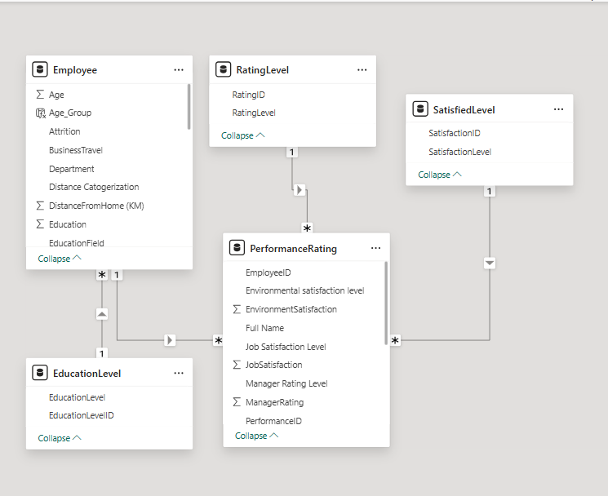
Data Modeling
A star schema was created by linking employee data with satisfaction levels, performance ratings, education, and rating levels for HR analysis.
Performance Rating is the fact table.
Other tables are Dimension Tables.
Education Level connects to Employee.
Satisfaction Level links to Performance Rating.
Rating Level is related to Performance Rating.
Employee is related to Performance Rating
Notes:
Data Model Summary (Star Schema)
PerformanceRating is the fact table, capturing job satisfaction, manager ratings, and environmental satisfaction.
Employee is a dimension table, linked via EmployeeID, providing demographic and job-related data.
EducationLevel connects to Employee, analyzing the impact of education on job roles.
SatisfactionLevel links to PerformanceRating, categorizing employees based on satisfaction scores.
RatingLevel is related to PerformanceRating, defining performance evaluation standards.
One-to-Many relationships ensure structured analysis, with Employee, Education, and Ratings as dimensions.
The model supports workforce insights, helping track performance, satisfaction, and retention trends.

Slide 8
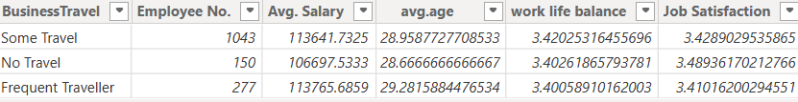
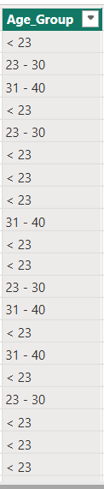
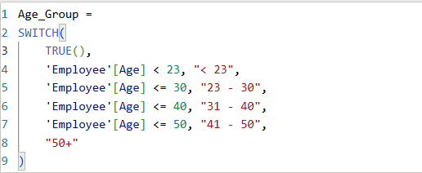
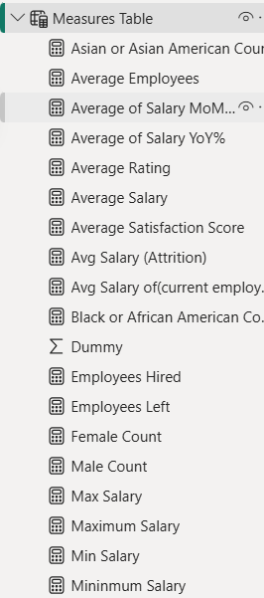
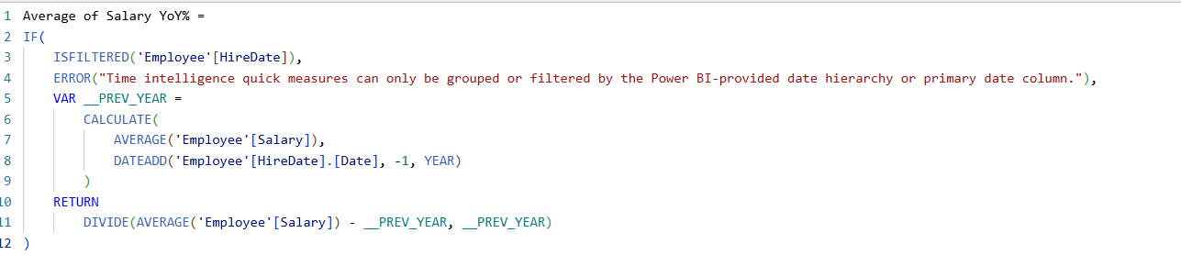
Dax Measures
DAX Tables:
DAX Columns:
DAX Measures:
Notes:
Data Model Summary (Star Schema)
PerformanceRating is the fact table, capturing job satisfaction, manager ratings, and environmental satisfaction.
Employee is a dimension table, linked via EmployeeID, providing demographic and job-related data.
EducationLevel connects to Employee, analyzing the impact of education on job roles.
SatisfactionLevel links to PerformanceRating, categorizing employees based on satisfaction scores.
RatingLevel is related to PerformanceRating, defining performance evaluation standards.
One-to-Many relationships ensure structured analysis, with Employee, Education, and Ratings as dimensions.
The model supports workforce insights, helping track performance, satisfaction, and retention trends.

Slide 9
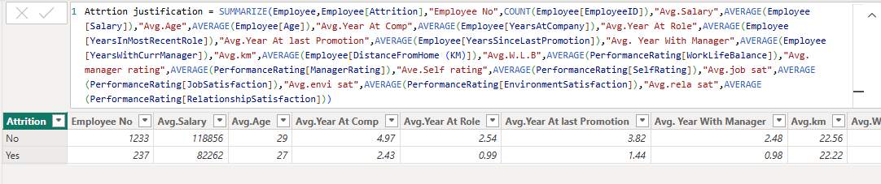
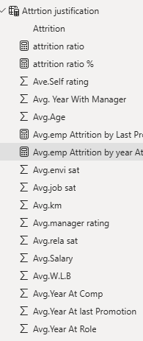
Dax Measures
DAX Tables:
DAX Measures:
Notes:
Data Model Summary (Star Schema)
PerformanceRating is the fact table, capturing job satisfaction, manager ratings, and environmental satisfaction.
Employee is a dimension table, linked via EmployeeID, providing demographic and job-related data.
EducationLevel connects to Employee, analyzing the impact of education on job roles.
SatisfactionLevel links to PerformanceRating, categorizing employees based on satisfaction scores.
RatingLevel is related to PerformanceRating, defining performance evaluation standards.
One-to-Many relationships ensure structured analysis, with Employee, Education, and Ratings as dimensions.
The model supports workforce insights, helping track performance, satisfaction, and retention trends.

Slide 10
Analysis Prospectives
Hiring Trend
Employee demographic distributions
Employee Diversity
Salary Analysis
Employees satisfactions & rating wok life
Attrition justifications & Recommendations

Slide 11
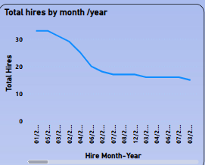
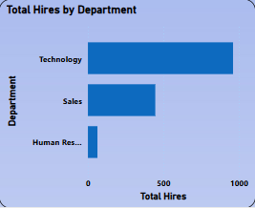
Hiring Trending
This report providing key insights into our hiring trends, departmental recruitment, and workforce expansion over time.
Line chart to show total hires over time, revealing a consistent decline from 30 to 14, possibly due to organizational changes, seasonal patterns, or shifts in hiring strategy.
Bar chart to show total hires by department, revealing Technology as the dominant hiring area, followed by Sales, with minimal hiring in HR.
Notes:
Total Hires: 1,470 employees
Hiring and Performance Over Time
Sharp decrease in both number of hires and performance evaluations over time.
Specific point highlighted: In March 2013, 14 hires and 107 performance evaluations were noted.
Hiring by Department
Technology: 961 hires (65.37% of total hires)
Sales: 464 hires (30.34% of total hires)
Human Resources: 63 hires (4.29% of total hires)
The majority of hiring is concentrated in the Technology department.
Top Roles Hired:
Software Engineer: 294 hires
Sales Executive: 327 hires
Data Scientist: 261 hires
Machine Learning Engineer: 146 hires
Others include Senior Software Engineer, Engineer, Analyst, Sales Representative, Manager, and HR Executive.

Slide 12
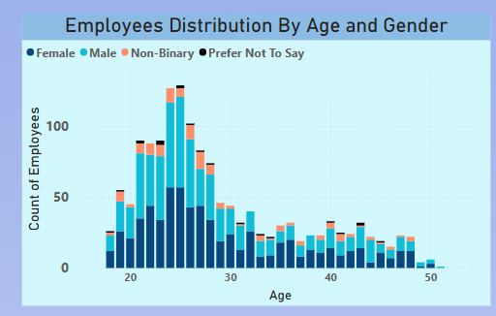
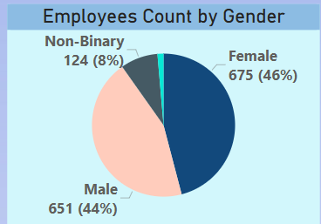
Employee Demographics
Demographics provide essential insights into the characteristics of a population within an organization, such as age, gender, ethnicity, and marital status.
Column chart showing the distribution of employees by age and gender, revealing a workforce heavily concentrated in the 20–30 age range, with a relatively even gender split among younger employees and more variation in older age groups.
Pie chart to display employee count by gender, revealing near-equal representation across male and female groups.
Notes:
Workforce Overview: Total of 1,470 employees, with a gender split of 651 males and 675 females.
Age Profile: Median age is 26; 59% of employees are within the 20 to 30 age range, targeting early career professionals.
Ethnic Diversity: Composition is 34% White, 18% Black or African American, and 12% Asian.
Salary Insights: Average salary for White employees is approximately 5% higher than for Asian and 10% higher than for Black or African American employees, indicating a need for a review of compensation equity.
Geographic Distribution: Employees are predominantly located in major urban centers, supporting regional operations effectively.
Employees with Long Commutes: Long Distance is 526 (Sales & Technology dominate), Very Long Commute is 443 (Majority in Sales & Technology), Medium Distance is 314 and Short Distance is 177
Job Roles with Highest Turnover: Sales Representative is 49.62% then Recruiter: 46.15% and Data Scientist is 26.96%
Lowest Turnover & Highest Retention: Senior Software Engineers is 0% turnover and HR Executives is 11.32% turnover, 88.68% retention

Slide 13
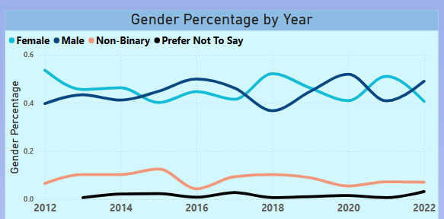
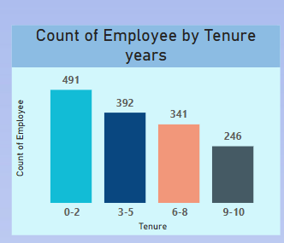
Employee Diversity
Diversity highlights the distribution of employees across job levels and tenure groups, offering insights into experience, Gender Percentage and Tenure Distribution.
Line chart tracking gender distribution over time revealing a dynamic shift between male and female representation, with noticeable consistency in non-binary and undisclosed identities. This visual helps assess progress toward gender balance across the years
Column chart showing employee distribution by tenure. Most employees are in the 0–2 year range, suggesting recent hires or high turnover
Notes:
White Employees: 860; Non-white Employees: 610
Job Levels: 818 Junior, 583 Mid-Level, 69 Senior
Most employees are White and in Junior roles
Gender trend: Female and Male proportions fluctuate closely over the years
Highest tenure group: 0–2 years with 491 employees
Gender in Junior roles: 360 Female, 377 Male, 71 Non-Binary
Gender in Mid-Level: 286 Female, 241 Male, 48 Non-Binary
Senior roles dominated by Male and Female with few others
Promotion Rate: Highest for Female (0.37), followed by Male (0.35)
Lowest promotion rate for ‘Prefer Not to Say’ group at 0.01

Slide 14
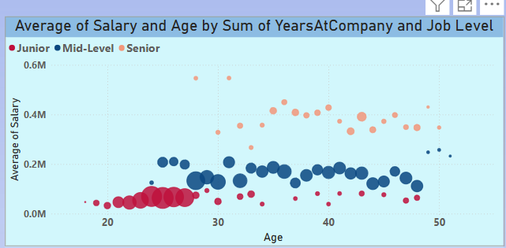
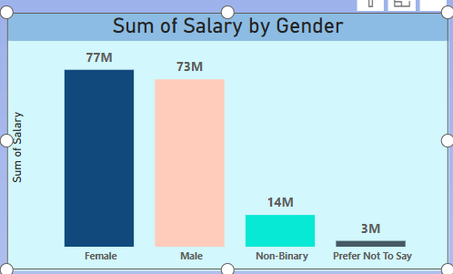
Salary Analysis
This report provides an in-depth analysis of salary trends, distribution by gender and department, and year-over-year salary growth fluctuations.
Scatter chart illustrating the relationship between age, job level, and salary—showing a clear salary growth trend with age, while also highlighting senior employees who are either highly compensated or potentially underpaid relative to their experience.
Column chart to compare total salary distribution by gender, revealing gender-based compensation contributions
Notes:
Overall Salary Insights
Average Salary: $112.96K
Total Salary Sum: 166M
Maximum Salary: $547.2K
Minimum Salary: $20.39K
Salary Trends & Distribution
Year-over-Year Salary Growth: Fluctuations observed, with major declines in 2015 (-23.83%) and 2022 (-23.56%), while peak growth occurred in 2020 (+22.21%).
Salary by Age: Positive correlation—salaries generally increase with age.
Salary Breakdown by Gender
Males earn the largest salary share (73M, 43%).
Females account for 77M in total salary.
Non-binary employees represent 8.32% (14M) of total salary distribution.
Departmental Salary Comparison
Technology department leads in salary levels across genders.
Sales and HR salaries vary, with HR generally having lower earnings.
Non-binary employees earn higher average salaries in Technology.

Slide 15
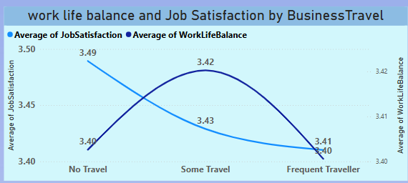
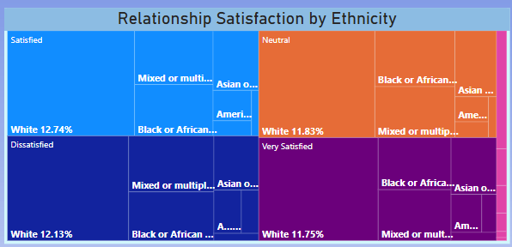
Employees Satisfactions & Rating
This report analyzes employee satisfaction, job perception, and manager ratings, influenced by environmental conditions, training opportunities, ethnicity, and years at the company.
Line chart visualizing the impact of business travel on job satisfaction and work-life balance, showing a decline in both metrics as travel frequency increases
Tree-map showing relationship satisfaction by ethnicity, revealing diverse satisfaction patterns across demographic groups.
Notes:
Environmental Satisfaction
30% of employees are very satisfied, while 33% remain neutral.
Dissatisfied employees (2%) indicate minimal workplace dissatisfaction.
Job Satisfaction
Satisfaction levels are balanced, with 1.69K satisfied employees and 1.67K dissatisfied employees.
Very dissatisfied employees are only 7.7%, showing low extreme dissatisfaction.
Relationship Satisfaction by Ethnicity
White employees show higher satisfaction, while dissatisfaction is observed across Black, Asian, and mixed ethnicities.
Manager Ratings
Exceeds Expectation (33.09%) and Meets Expectation (30.95%) dominate performance reviews.
Needs Improvement (17.77%) and Above and Beyond (16.01%) indicate room for growth and high performers.

Slide 16
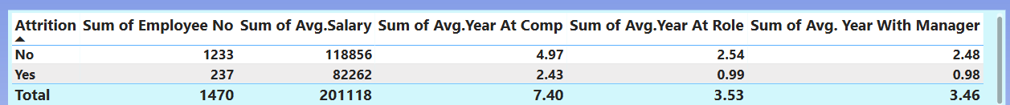
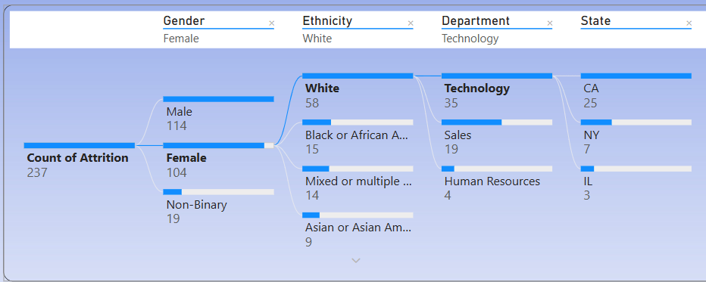
Attrition Justification & Analysis
Through several reports, we created several charts to determine the main reason behind employee's resignations from the company whether it is due to salaries, work environment, distance between home and workplace, level of education, ethnicity, or gender
Table comparing attrition with key metrics, revealing that leavers had lower salaries, fewer years at the company, shorter time in role, and less tenure with managers.
Decomposition tree breaks down attrition count across gender, ethnicity, department, and state, revealing key loss areas like white females in tech from California.

Slide 17
Recommendations
Observation | Recommended Actions
Ethnic diversity is limited with 58.5% of employees being White, highlighting an imbalance in workforce representation. | Implement bias-free hiring to ensure 30% of new hires reflect underrepresented ethnic backgrounds.
The average commute distance is 22.5 km, with some employees traveling significantly farther. | Introduce flexible working options and remote work opportunities, aiming to reduce average commute times by 20%.
Minimize the salary gap between the highest and lowest paying departments which is 526,817. | Reduce salary gap from to less than $5,000 by implementing structured annual salary adjustments of 2-3% over the next three years.
Average work-life balance score is 3.4. | Increase the score to 4.0 through flexible working options and workload reviews.
The attrition rate in the Technology department is currently approximately 13.84% annually. | Aim to lower this rate to under 10% by 2025 through strategic enhancements in career development.
17.77% of employees received 'Needs Improvement' ratings to Managers, totaling 1,192 individuals | Reduce 'Needs Improvement' ratings to below 10% through personalized coaching and structured quarterly progress reviews.

Slide 18
Recommendations
Observation | Recommended Actions
The company’s attrition rate is 16%, above the market average of 10%. | Implement strategies to align with industry benchmarks and reduce attrition.
Resigned employees have lower average salaries ($82,262) than retained employees ($118,856). | Review and adjust salary structures to remain competitive and retain talent.
Tenure at the company is shorter for resigned employees (2.43 years) compared to others (4.97 years). | Investigate early-stage disengagement and improve onboarding and career development paths.
Resigned employees spent less time in their role (0.99 years) and with their manager (0.98 years), vs. 2.54 and 2.48 years for others. | Strengthen internal mobility and manager-employee relationships through mentorship and structured role development.
65% of resigned employees received no share distributions. | Expand equity-based incentives and communicate long-term benefit opportunities clearly.

Slide 19


Microsoft Power BI

Slide 20





Thank You
April Hansson
+1 23 987 6554
april@treyresearch.com
Trey Research

